Slide 1
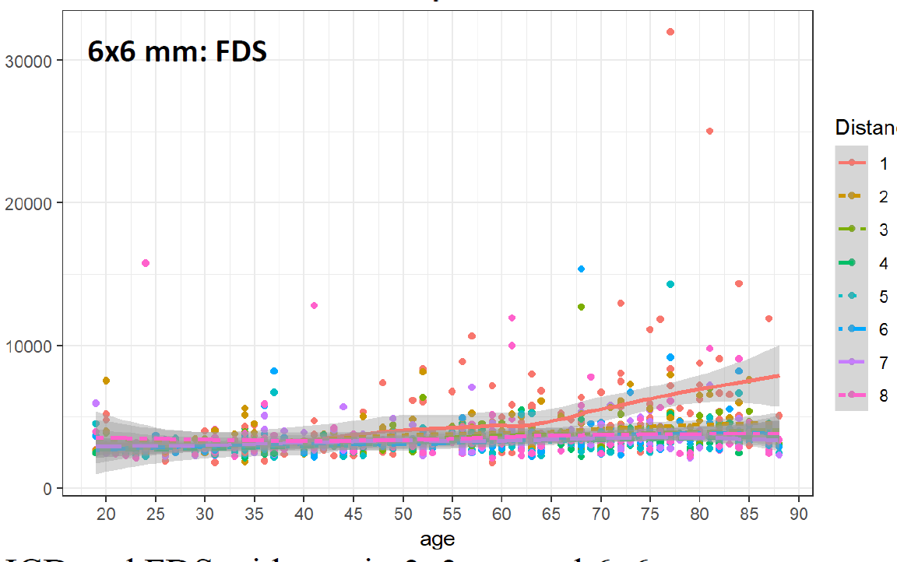
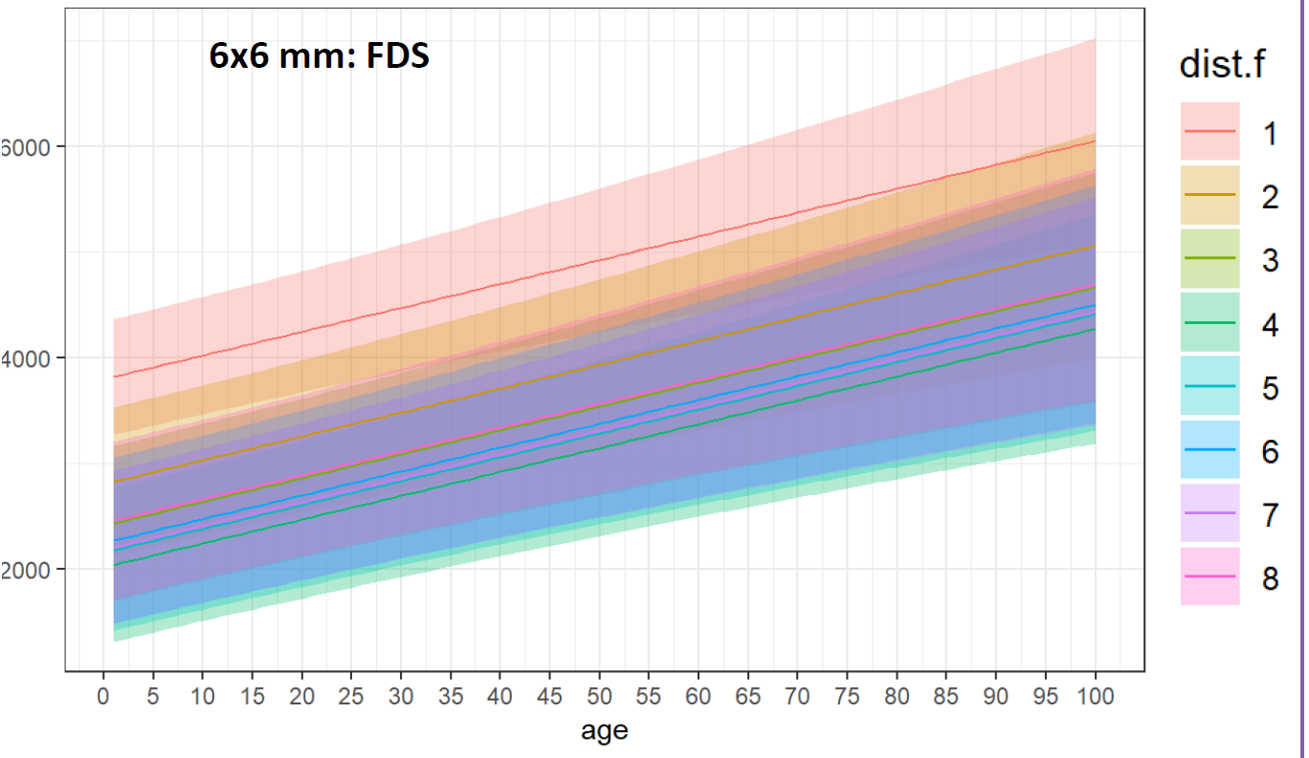
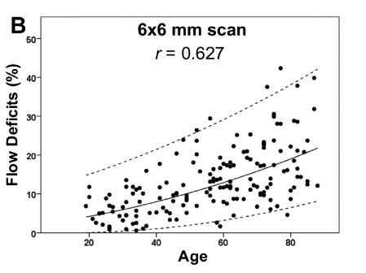
Q1: we want the 95% prediction/tolerance/normal limits (ie, 95% CI on future measurements, not 95% CI on the estimate of the relationship with age). I extracted the 95% CI graph from the poster and attempted to scale it to the empirical data. The limits look too narrow to be 95% normal?
FDs = Flow Deficits
ICD = Intercapillary Distance
DF = distance from fovea
6000
2000
Q2: this figure is from our normal limits paper (AJO 2019;200:110–122) for the 1mm circle using ordinary linear regression with a broken stick model and a power transformation to account for heterogeneity of FD variances over the age range. The 1mm 95% normal limits get quite wide with age. The 6x6mm FDS empirical data suggest this might be true here as well but we don’t see it reflected in these normal limits. Is that right?
1mm circle
Q3: in our approach we fit separate models within each 1, 2.5, 5 mm circle. The GEE gives you marginal coefficients and SE adjusted for the correlation allowing correct significance tests of coefficients using all DF data in a single model, but
How would this be used when evaluating the next case for normality? Is their some joint test taking into account all DFs? (which would be cool)
The equivalent VCV matrix for GEE is complicated (due to correlation structure*). How is this incorporated into the prediction limit (m ± t_{α/2} √[(MSE) (1 + a^{T} (X^{T} X)⁻¹ a)] for OLR). If you have a reference I would like to read about it.
* Which correlation structure did you use?
Notes:
Q1: it is directly from our estimates. It display the variation of our estimates. Since most measures are close to each other, they are not wide.
Q2: It is wide because the data is scaled. Then the estimates are interpreted differently. (for example, if log(outcome), the coefficients represent if 1 unit increases in covariate, the proportion of outcome increases (not the absolute number))
Q3: (1) (If I understand the question correctly) Normality is for the behavior of estimates from large sample size. That means if we have large enough sample size, the statistics (something is a function of our observations) we care about behaves like a normal distributed variable (e.g, if we want to know the height of people in one population, then we are able to say that the mean height behaves like a normal distributed variable. And we can have the CI to show our confidence). Once we have the new case (we already have parametrized model and have our confidence), we can see whether the new case is against/support to our belief. All the steps can be done by standard fashion.
(2) GEE consider the case that there are clusters in the dataset (one person may have multiple measures). If we don’t account it into consideration, our SE for estimate is incorrect (the SE of estimates from OLS is incorrect). GEE use the SE which is called robust sandwich-bases SEs, that is say even if we misspecify the correlation structure, we still have a good estimate for SE.

